Slide 1
Chapter 6 Security Protocols
Chapter 6.2
SSL

Slide 2



Cloud Computing

Slide 3
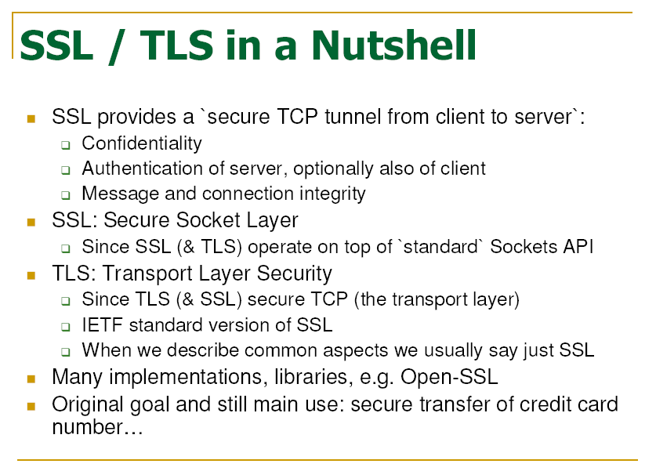
Notes:
TCP port number is 443.
The default port to enable for SSL is Port 443.

Slide 4
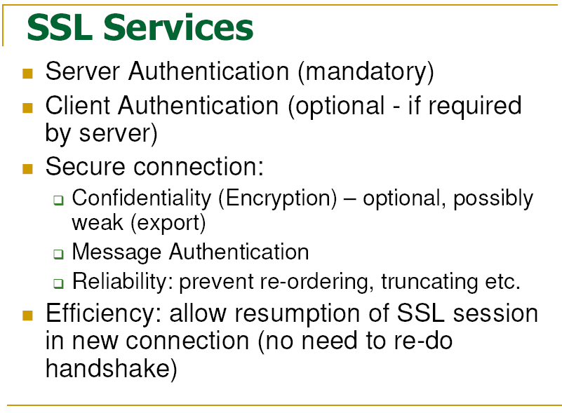

Slide 5
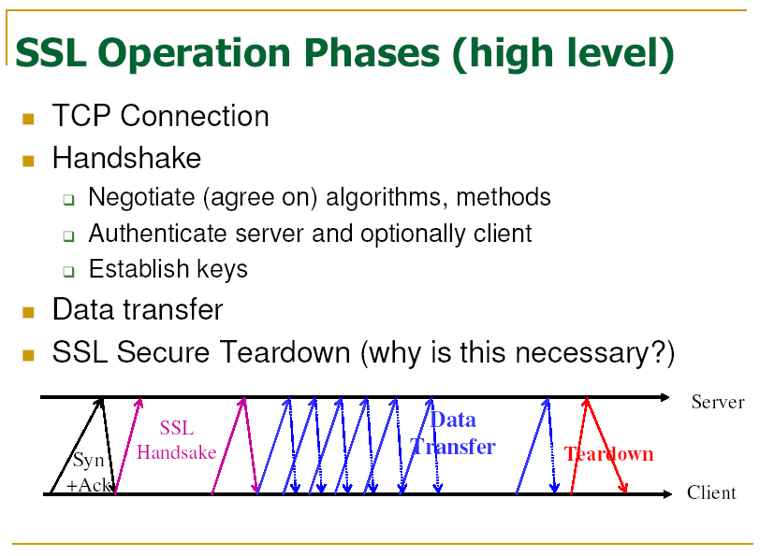

Slide 6
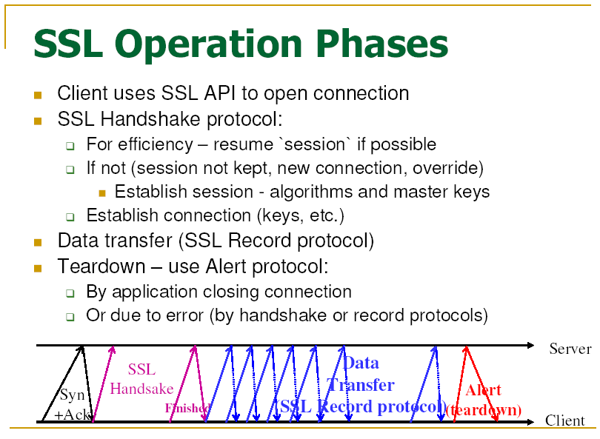
Notes:
The 443 is the default TCP port used for HTTPS.

Slide 7
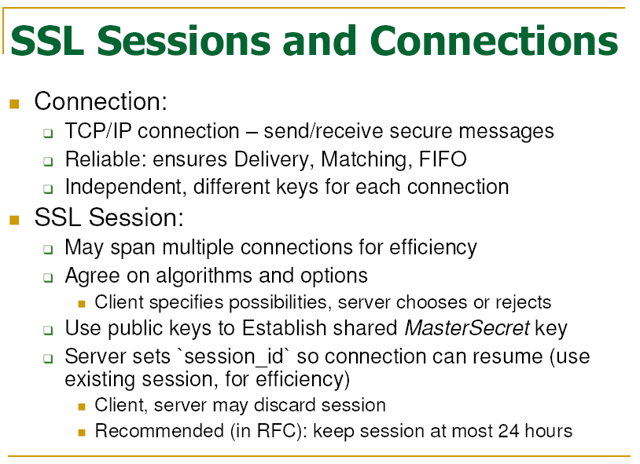
Notes:
SSL runs in sessions. Each session comprises multiple connections.

Slide 8
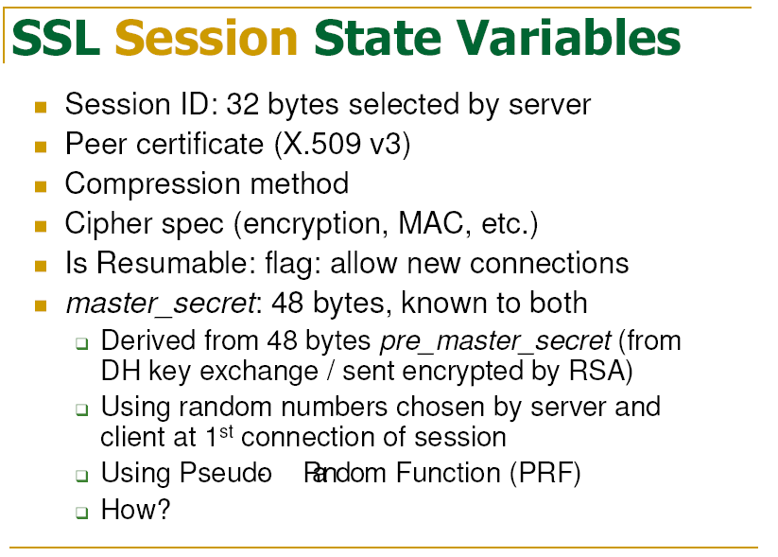

Slide 9
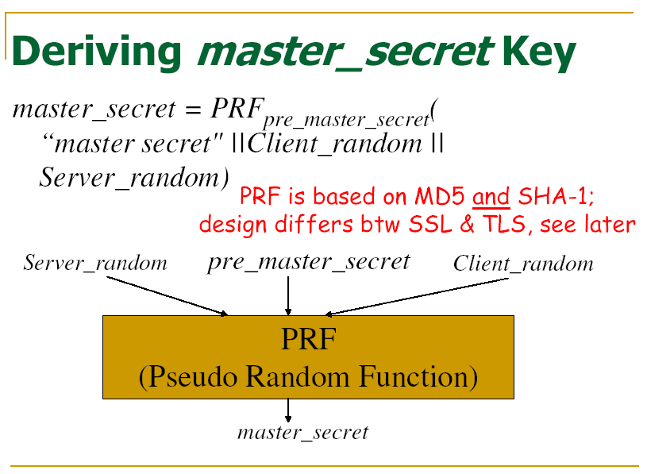

Slide 10
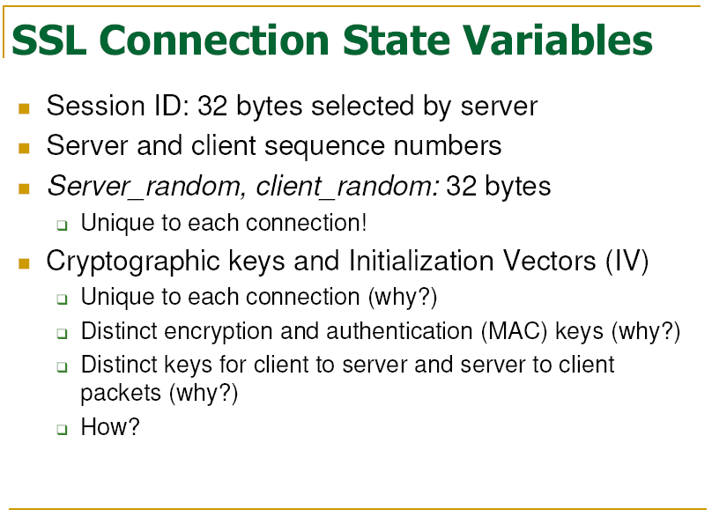
Notes:
Replaying attack

Slide 11
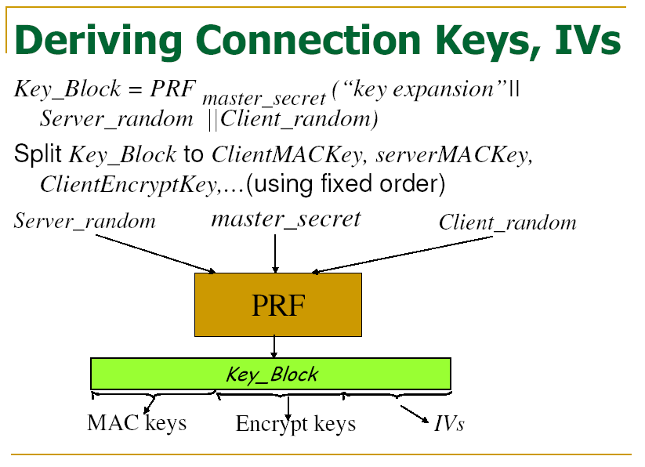

Slide 12
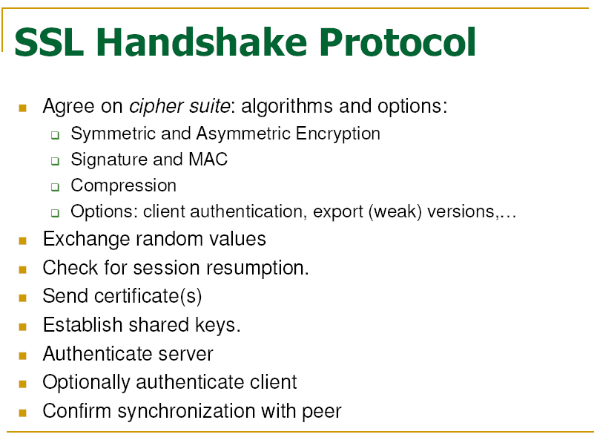

Slide 13
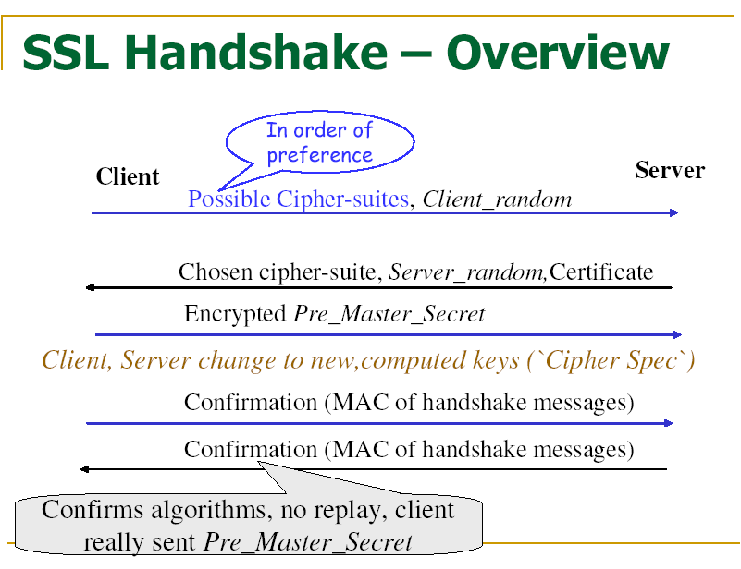

Slide 14
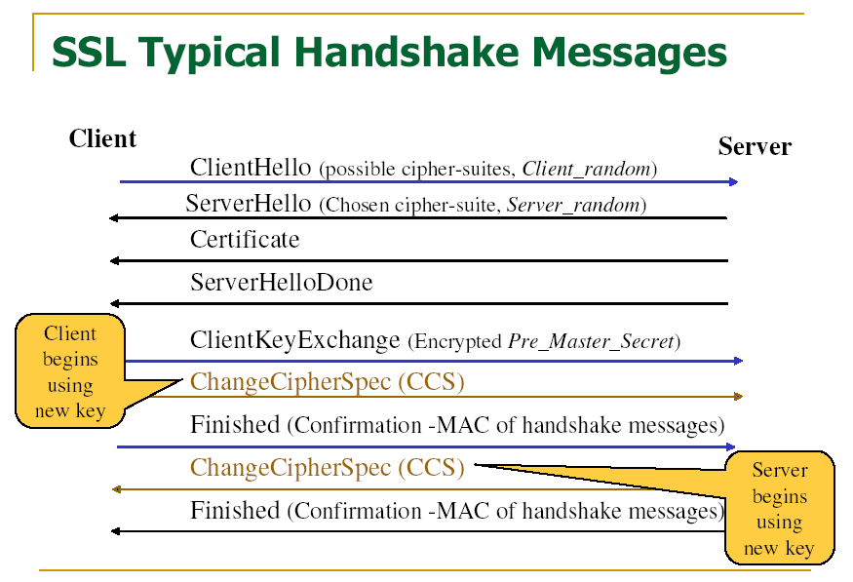

Slide 15
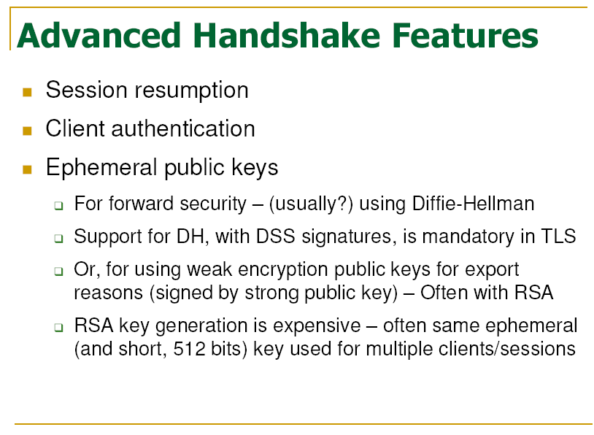

Slide 16
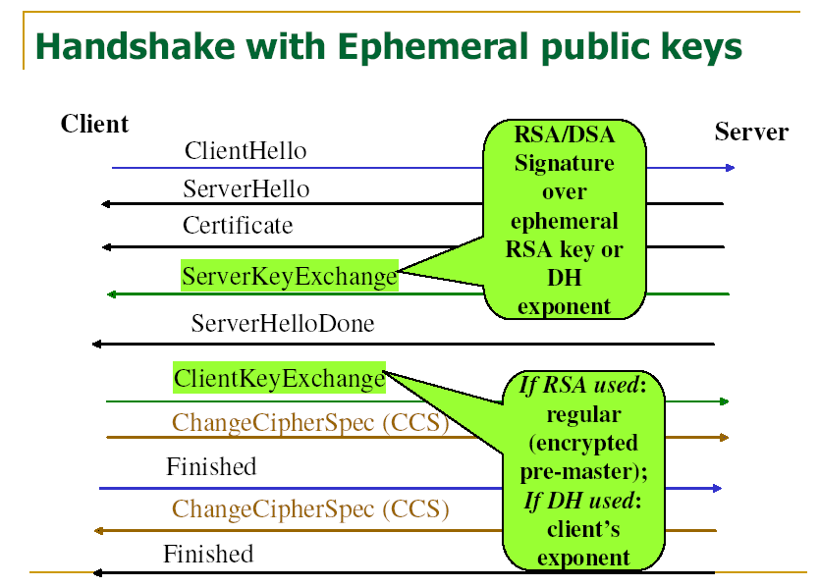

Slide 17
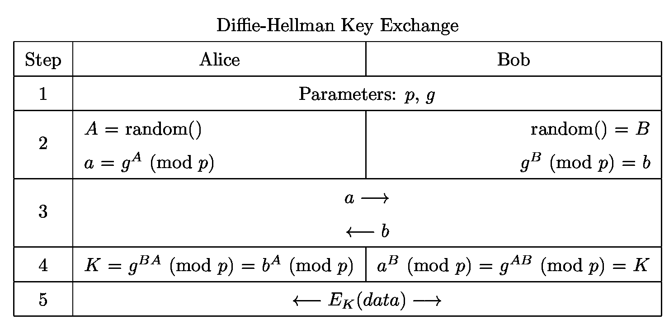
Diffie-Hellman Key Exchange

Slide 18
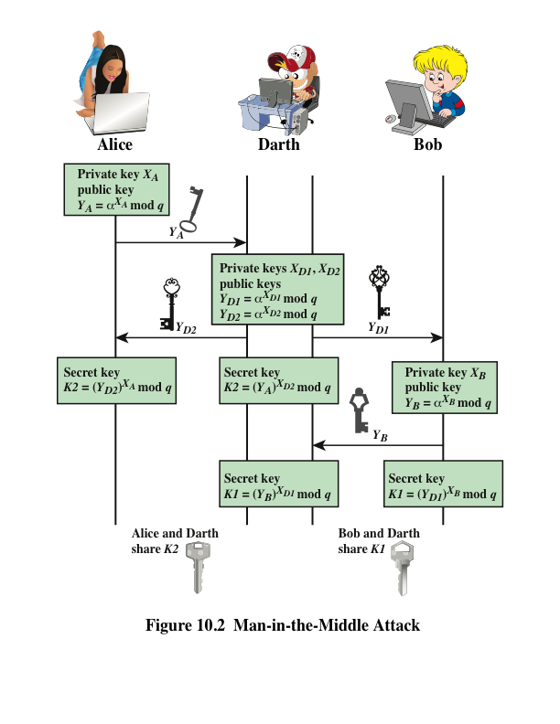
Notes:
The protocol depicted in Figure 10.1 is insecure against a man-in-the-middle attack.
Suppose Alice and Bob wish to exchange keys, and Darth is the adversary. The
attack proceeds as follows (Figure 10.2).
Darth prepares for the attack by generating two random private keys X_{D1} and X_{D2} and then computing the corresponding public keys Y_{D1} and Y_{D2}
Alice transmits Y_{A} to Bob.
Darth intercepts Y_{A} and transmits Y_{D1} to Bob. Darth also calculates K2 = (Y_{A} )^ X_{D2} mod q
Bob receives Y_{D1} and calculates K1=(Y_{D1} )^ X_{B} mod q
Bob transmits Y_{B} to Alice.
Darth intercepts Y_{B} and transmits Y_{D2} to Alice. Darth calculates K1=(Y_{B} )^ X_{D1} mod q
Alice receives Y_{D2} and calculates K2=(Y_{D2} )^ X_{A} mod q .
At this point, Bob and Alice think that they share a secret key, but instead Bob and Darth share secret key K1 and Alice and Darth share secret key K2. All future communication between Bob and Alice is compromised in the following way:
Alice sends an encrypted message M: E(K2, M).
Darth intercepts the encrypted message and decrypts it, to recover M.
Darth sends Bob E(K1, M) or E(K1, M'), where M' is any message. In the first case, Darth simply wants to eavesdrop on the communication without altering it. In the second case, Darth wants to modify the message going to Bob.
The key exchange protocol is vulnerable to such an attack because it does not authenticate the participants. This vulnerability can be overcome with the use of digital signatures and public- key certificates.

Slide 19
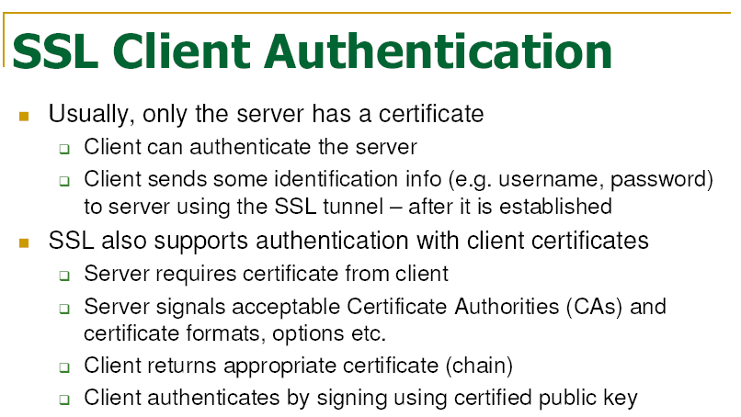

Slide 20
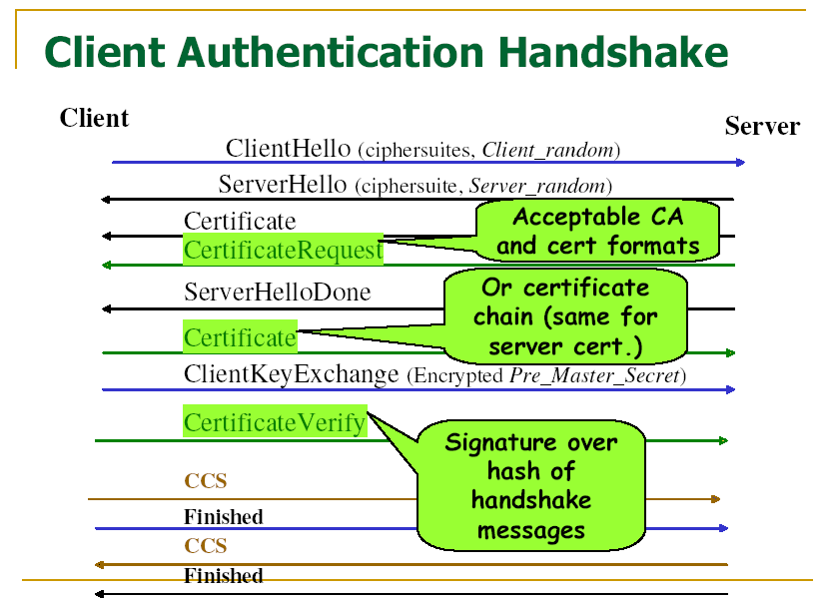

Slide 21
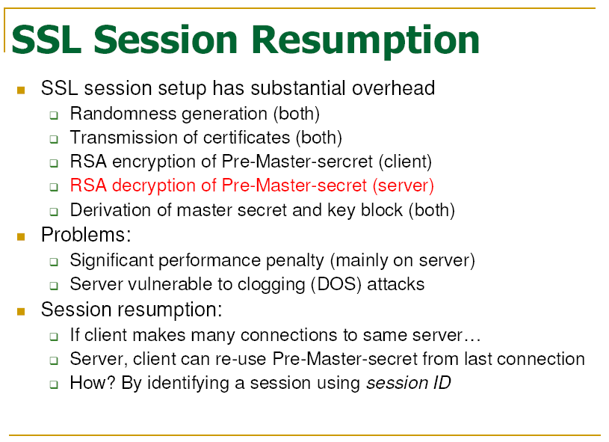

Slide 22
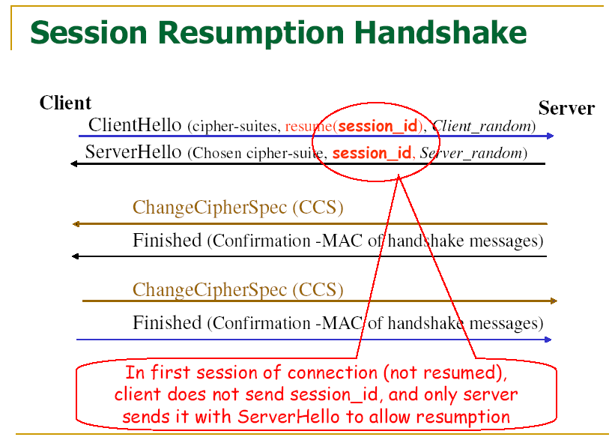

Slide 23
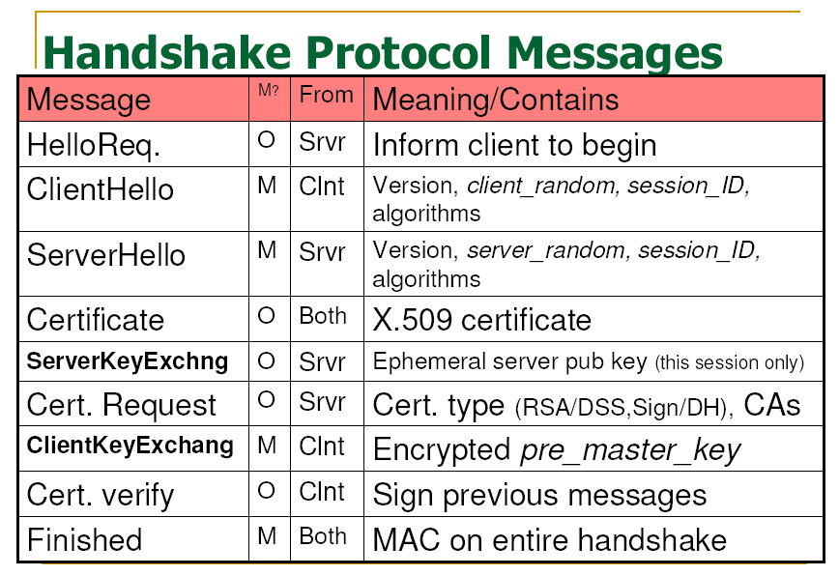

Slide 24
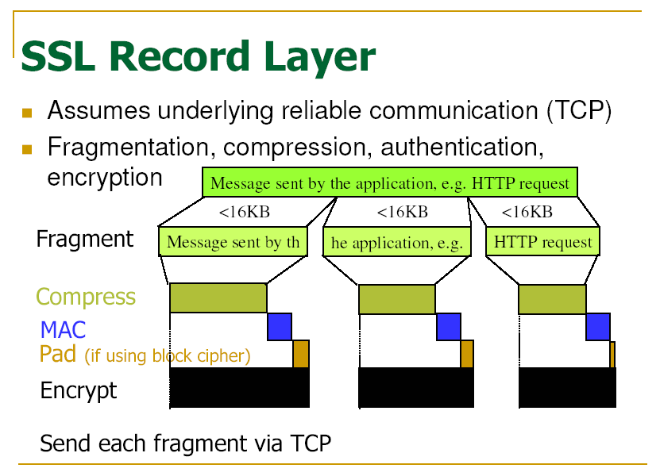

Slide 25
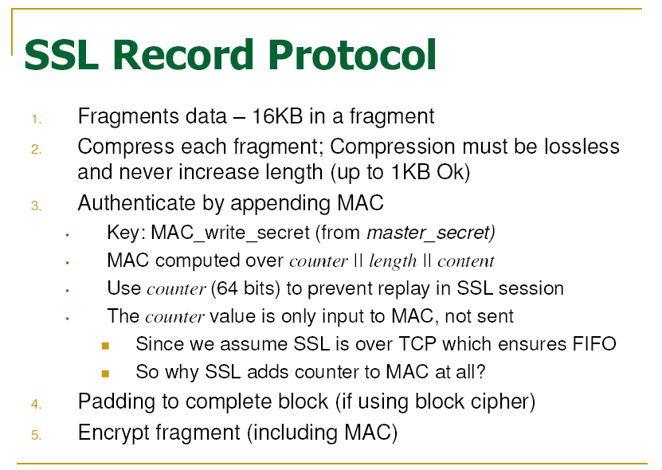
Notes:
First-In-First-Out (FIFO)

Slide 26
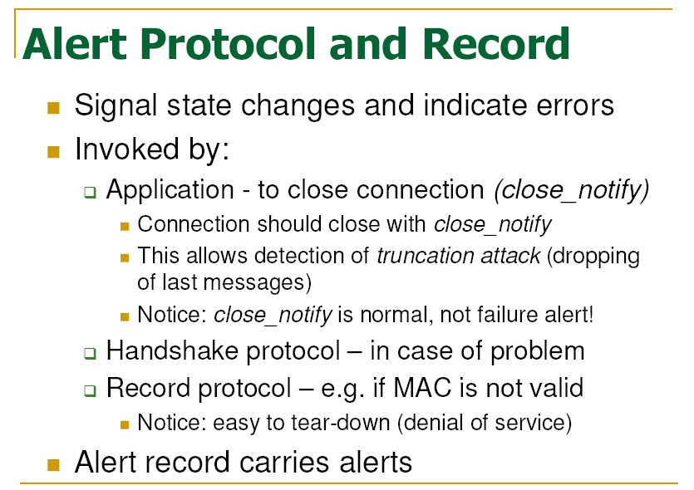

Slide 27
Chapter 6 Security Protocols
Chapter 6.3
IPSec

Slide 28
The IPSec Security Model
Secure
Insecure

Slide 29
IPSec Architecture
ESP
AH
Encapsulating Security
Payload
Authentication Header
IPSec Security Policy
IKE
The Internet Key Exchange

Slide 30
IPSec Architecture
IPSec provides security in three situations:
Host-to-host, host-to-gateway and gateway-to-gateway
IPSec operates in two modes:
Transport mode (for end-to-end)
Tunnel mode (for VPN)

Slide 31
IPsec Architecture
Transport Mode
Router
Router
Tunnel Mode

Slide 32
Various Packets
Original
IP header
TCP header
data
Transport
mode
IP header
IPSec header
TCP header
data
Tunnel
mode
New IP header
IPSec header
IP header
TCP header
data

Slide 33
IPSec
A collection of protocols (RFC 2401)
Authentication Header (AH)
RFC 2402
Encapsulating Security Payload (ESP)
RFC 2406
Internet Key Exchange (IKE)
RFC 2409
IP Payload Compression (IPcomp)
RFC 3137

Slide 34
Internet Key Exchange (IKE)
Exchange and negotiate security policies
Establish security sessions
Identified as Security Associations
Key exchange
Key management

Slide 35
How It Works
IKE operates in two phases
Phase 1: negotiate and establish an auxiliary end-to-end secure channel
Used by subsequent phase 2 negotiations
Only established once between two end points!
Phase 2: negotiate and establish custom secure channels
Occurs multiple times
Both phases use Diffie-Hellman key exchange to establish a shared key
IKE protocol initial message exchanges are not encrypted.
IKE uses (normally) the UDP port 500.

Slide 36
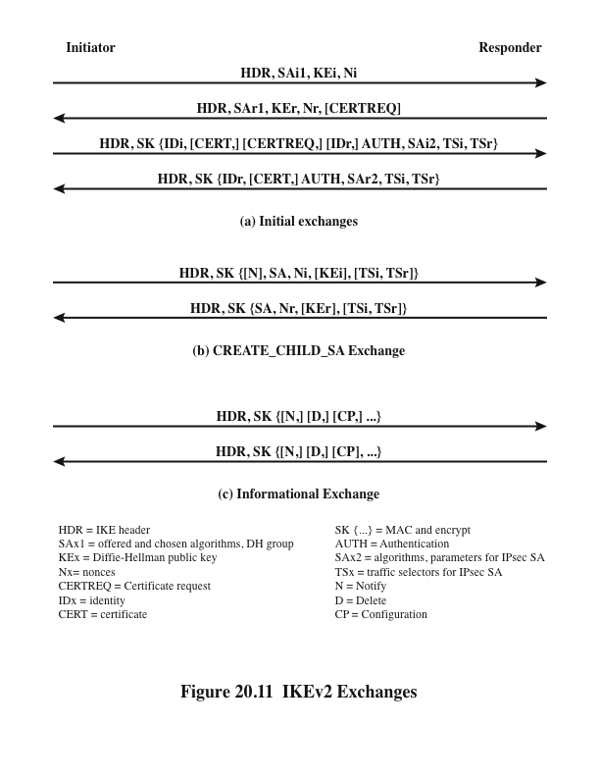
Internet Key Exchange (IKEv2)
Notes:
Using the Elliptic Curve Cryptography (ECC) Brainpool Curves for the Internet Key Exchange Protocol Version 2 (IKEv2) https://www.rfc-editor.org/rfc/rfc6954.html
A traffic selector is an agreement between IKE peers to permit traffic through a tunnel if the traffic matches a specified pair of local and remote addresses.

Slide 37
Authentication Header (AH)
Provides source authentication
Protects against source spoofing
Provides data integrity
Protects against replay attacks
Use monotonically increasing sequence numbers
Protects against denial of service attacks
NO protection for confidentiality!

Slide 38
AH Details
Use 32-bit monotonically increasing sequence number to avoid replay attacks
Use cryptographically strong hash algorithms to protect data integrity (96-bit)
Use symmetric key cryptography
HMAC-SHA-96, HMAC-MD5-96

Slide 39
AH Packet Details
New IP header
Next
header
Payload
length
Reserved
Security Parameters Index (SPI)
Authenticated
Sequence Number
Encapsulated
TCP or IP packet
Old IP header (only in Tunnel mode)
TCP header
Hash of everything
else
Data
Authentication Data

Slide 40
Encapsulating Security Payload (ESP)
Provides all that AH offers, and
in addition provides data confidentiality
Uses symmetric key encryption

Slide 41
ESP Details
Same as AH:
Use 32-bit sequence number to counter replaying attacks
Use integrity check algorithms
Only in ESP:
Data confidentiality:
Uses symmetric key encryption algorithms to encrypt packets
Notes:
The AH protocol provides a mechanism for authentication only. AH provides data integrity, data origin authentication, and an optional replay protection service. Data integrity is ensured by using a message digest that is generated by an algorithm such as HMAC-MD5 or HMAC-SHA. Data origin authentication is ensured by using a shared secret key to create the message digest. Replay protection is provided by using a sequence number field with the AH header. AH authenticates IP headers and their payloads, with the exception of certain header fields that can be legitimately changed in transit, such as the Time To Live (TTL) field.
The ESP protocol provides data confidentiality (encryption) and authentication (data integrity, data origin authentication, and replay protection). ESP can be used with confidentiality only, authentication only, or both confidentiality and authentication. When ESP provides authentication functions, it uses the same algorithms as AH, but the coverage is different. AH-style authentication authenticates the entire IP packet, including the outer IP header, while the ESP authentication mechanism authenticates only the IP datagram portion of the IP packet.

Slide 42
ESP Packet Details
IP header
Next
header
Payload
length
Reserved
Security Parameters Index (SPI)
Sequence Number
Authenticated
Initialization vector
TCP header
Data
Encrypted TCP
packet
Pad
Pad length
Next
Authentication Data

Slide 43
SA/SADB
Security Association (SA)
Collection of attribute associated with a connection, containing keys and other relevant information for the connection.
Is asymmetric!
One SA for inbound traffic, another SA for outbound traffic
Security Association Database (SADB)
A database of SAs

Slide 44
SPI/SPD
Security Parameter Index (SPI)
A unique index for each entry in the SADB
Identifies the SA associated with a packet
Security Policy Database (SPD)
Store policies used to establish SAs

Slide 45
How They Fit Together
SPD
SA-1
SA-2
SADB
SPI
SPI

Slide 46
SPD and SADB Example
Transport Mode
A’s SPD
From | To | Protocol | Port | Policy
A | B | Any | Any | AH[HMAC-MD5]
A
B
C
D
Tunnel Mode
From | To | Protocol | SPI | SA Record
A | B | AH | 12 | HMAC-MD5 key
A’s SADB
From | To | Protocol | Port | Policy | Tunnel Dest
 |  | Any | Any | ESP[3DES] | D
A_{sub}
B_{sub}
C’s SPD
From | To | Protocol | SPI | SA Record
 |  | ESP | 14 | 3DES key
C’s SADB
A_{sub}
B_{sub}

Slide 47
